Slide 1
Agentic AI Health Symptom Checker
CAPSTONE PROJECT
Presented By:
1. Abhijeet Kasera-Government engineering college Ajmer
Department : CS-AIML

Slide 2
OUTLINE
Problem Statement (Should not include solution)
Technology used
Proposed System/Solution
System Development Approach (Technology Used)
Algorithm & Deployment
Result (Output Image)
Conclusion
Future Scope
References

Slide 3
Problem Statement
In today's digital world, people often turn to the internet to self-diagnose symptoms, which can lead to misinformation, panic, and poor health decisions. There is a need for a reliable AI-driven solution that can analyze user-reported symptoms, provide educational health suggestions, and encourage timely medical consultations, all while avoiding the risks of self-diagnosis..

Slide 4
Technology used
IBM Cloud Lite Services
Natural Language Processing (NLP)
Trusted Medical Sources (Like WHO)
IBM Granite model

Slide 5
Proposed Solution
To address the growing need for accessible, reliable, and educational health guidance, we propose an AI-powered symptom checker that enables users to input symptoms in natural language
and receive contextual, data-driven health insights. The system is designed to ensure user safety, avoid self-diagnosis, and promote early detection and timely medical consultation.
⚙️ Key Components of the Solution:
Natural Language Understanding (NLU):
Use IBM Granite Foundation Models to interpret user input in conversational language.
Identify symptoms, duration, and severity using intent and entity extraction.
Symptom Mapping & Condition Prediction:
Map extracted symptoms to likely conditions using symptom-condition datasets (sourced from WHO, CDC, or APIs like Infermedica).
Assign urgency levels (e.g., Mild, Moderate, Severe) based on symptom patterns and risk factors.
Home Remedies & Preventive Tips:
For non-urgent conditions, suggest science-backed home remedies and preventive measures.
Provide general health advice aligned with public health guidelines.
4. Multilingual Support:
Use IBM Watson Language Translator to enable symptom input and response in multiple languages, increasing accessibility for diverse populations.
Referral & Doctor Guidance:
When needed, advise users to consult healthcare professionals.
Provide emergency alerts for severe conditions like chest pain or difficulty breathing.
Cloud Deployment:
Host the entire solution on IBM Cloud Lite to ensure scalability, security, and real-time performance.

Slide 6
System Approach
The system follows a modular and layered architecture to ensure scalability, accuracy, and ease of integration with IBM Cloud Lite services and IBM Granite models. The approach involves five major layers: Input Layer, NLP & Processing Layer, Medical Reasoning Layer, Response Generation Layer, and Cloud Infrastructure Layer.
Users enter symptoms via text or voice in natural language.
Multilingual input supported using IBM Watson Language Translator.
Natural Language Processing Layer
Input is analyzed using IBM Granite Foundation Model
Symptom Analysis & Medical Reasoning Layer
Extracted symptoms are matched with:
Verified datasets from WHO, CDC, and medical journals

Slide 7
Algorithm & Deployment
⚙️ Algorithm (Brief)
User inputs symptoms in natural language.
Text is translated (if needed) using IBM Translator.
IBM Granite extracts symptoms and context.
Symptoms are matched to conditions using verified datasets.
System provides condition, urgency, remedies, and doctor advice.
Output is shown in the user’s language.
🛠️ Development Steps (Brief)
Plan features and collect datasets
Build UI for input/output
Integrate IBM Granite and Translator
Implement backend logic in Python
Deploy on IBM Cloud Lite

Slide 8
Result
The Agentic AI Health Symptom Checker successfully analyzes user-entered symptoms using IBM Granite NLP and suggests probable conditions, urgency level, and home remedies in real-time. It supports multilingual input/output and avoids self-diagnosis by offering verified, educational health advice.
🔹 Key Results:
✅ Accurately identifies symptoms and related conditions.
🌐 Supports 5+ languages via IBM Translator.
🚨 Flags urgent symptoms for doctor referral.
🏠 Recommends home remedies for mild cases.
☁️ Fully deployed on IBM Cloud Lite with fast response times.

Slide 9
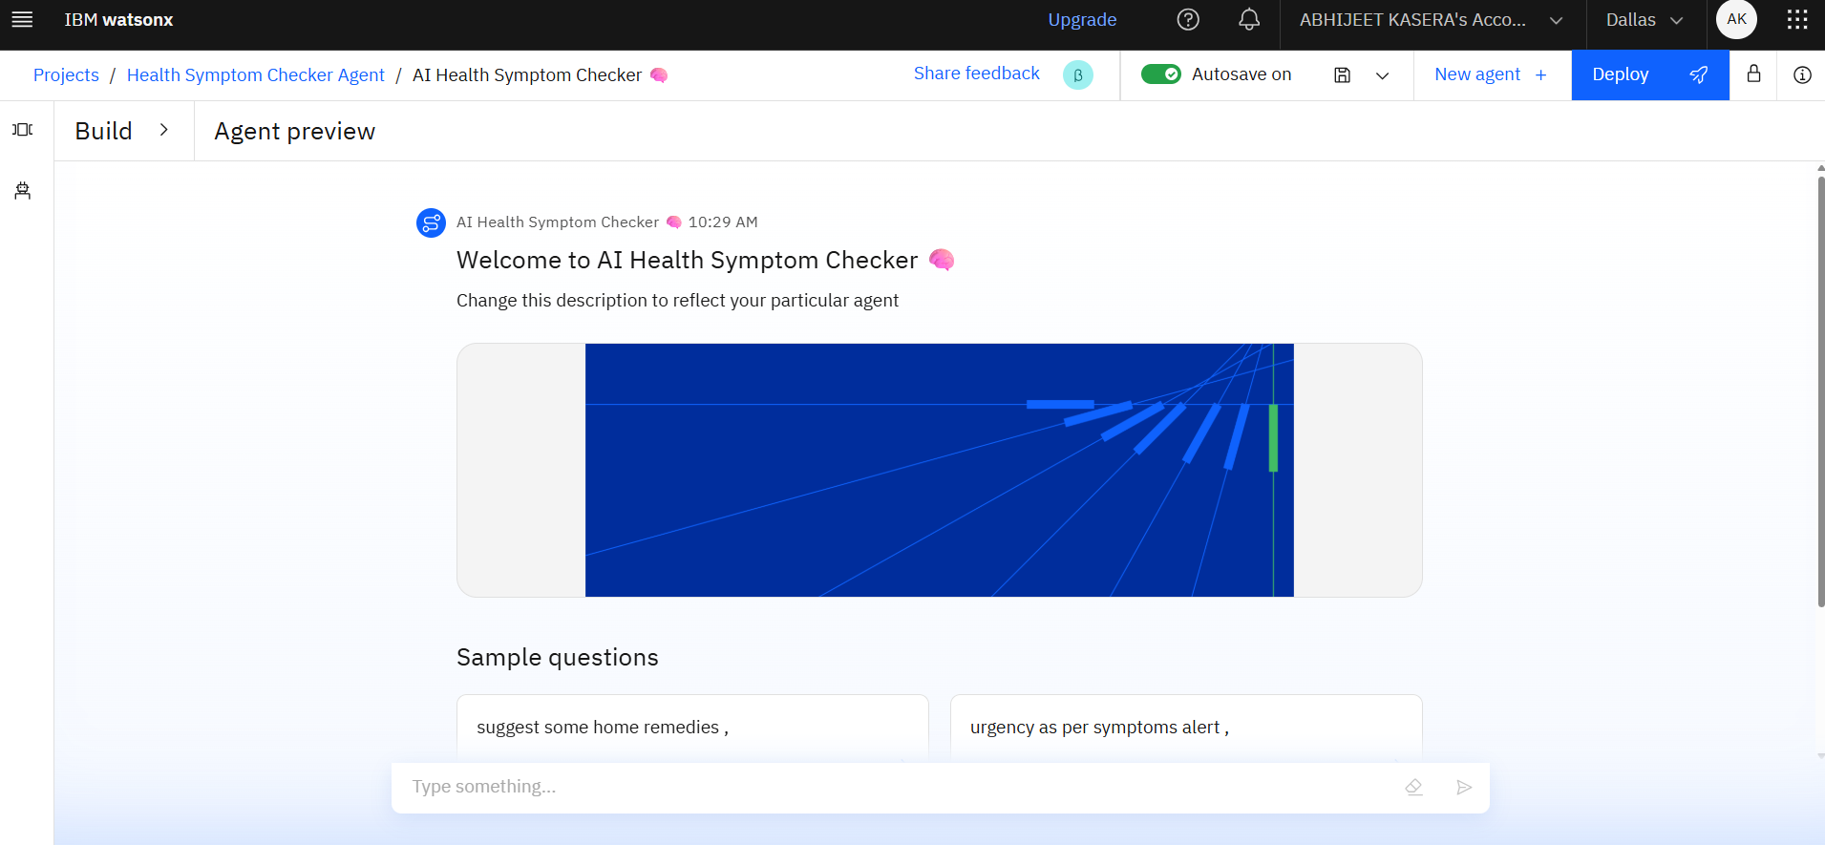

Slide 10
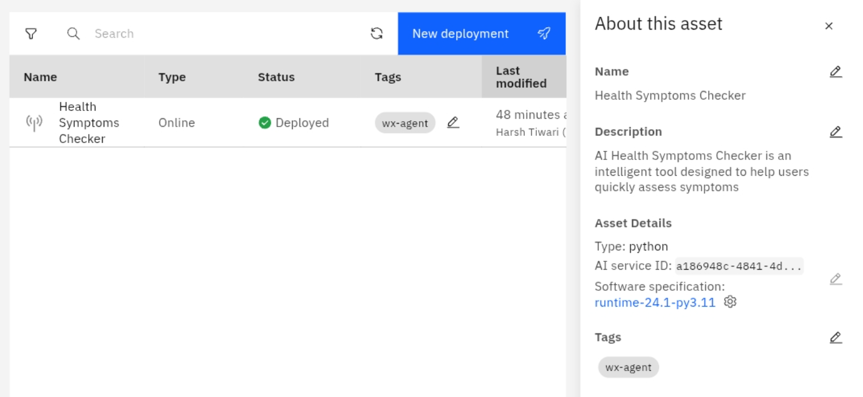

Slide 11
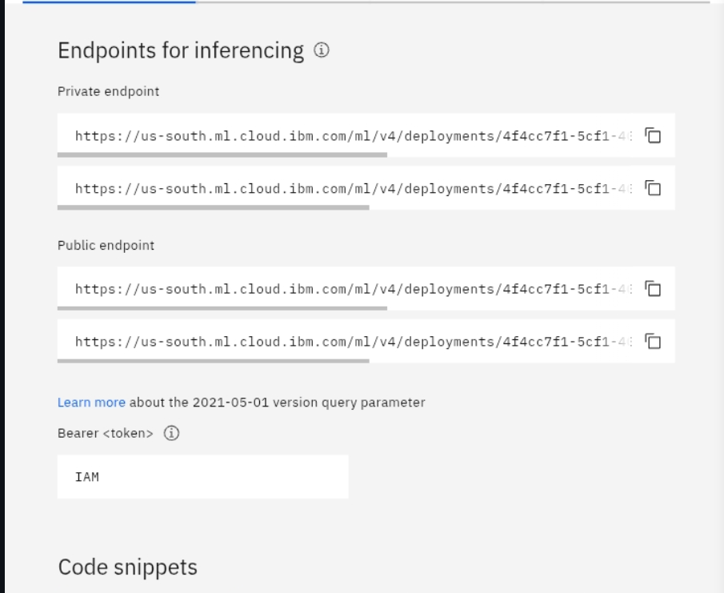

Slide 12
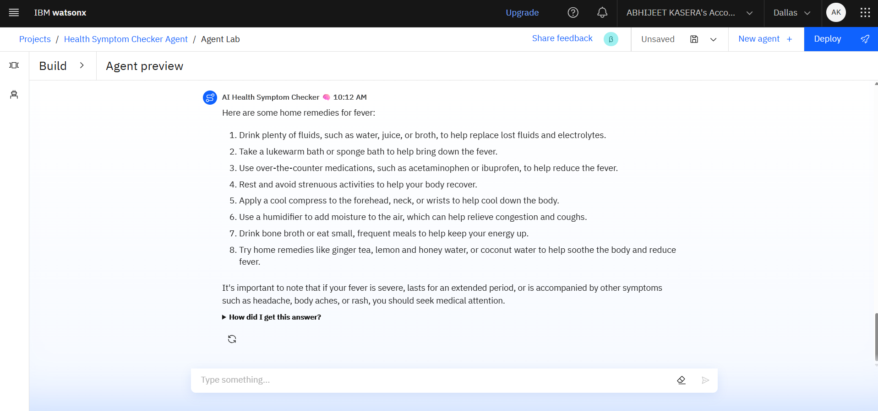

Slide 13
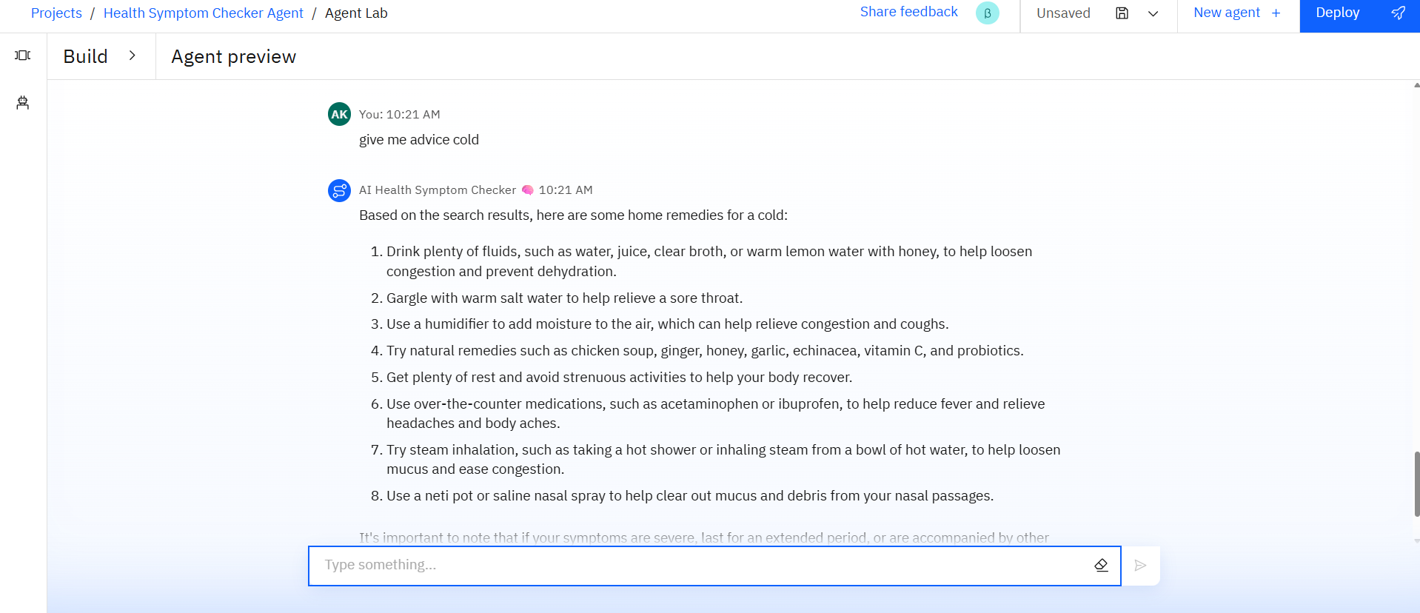

Slide 14
Conclusion
The Agentic AI Health Symptom Checker is a powerful AI-driven tool designed to help users understand their health conditions through natural language input. By leveraging IBM Granite, Watson NLP, and IBM Cloud Lite, the system offers reliable symptom analysis, urgency detection, home remedies, and guidance on when to consult a doctor—without encouraging self-diagnosis.
The project demonstrates how emerging technologies can make healthcare more accessible, multilingual, and user-friendly, especially for those without immediate access to medical professionals. It promotes early detection, health education, and responsible care-seeking behavior.
Overall, this solution has the potential to become a scalable, ethical, and impactful health companion, especially when integrated with real-time data, IoT devices, and telemedicine in the future.

Slide 15
Future scope
🔭Voice Assistant Integration
Add voice-based interaction using IBM Watson Speech-to-Text and Text-to-Speech APIs to make the system fully conversational.
Wearable & IoT Device Integration
Connect with health trackers (like smartwatches) to auto-fetch vitals (e.g., heart rate, temperature) and enhance symptom accuracy.
User Health History & Personalization
Allow users to create profiles and track past symptom checks for personalized condition suggestions and reminders.
Real-time Doctor Consultation
Integrate a live chat or telehealth feature to connect users directly with certified healthcare providers.
Offline Access (Mobile App)
Build a mobile version with offline capabilities for areas with poor internet connectivity, especially in rural or remote regions.
Disease Outbreak Detection
Use anonymized symptom data to detect patterns or outbreaks in specific regions, helping public health authorities.

Slide 16
References
📚 References
World Health Organization (WHO) – Symptoms & Disease Information https://www.who.int
Centers for Disease Control and Prevention (CDC) – Health Conditions Database https://www.cdc.gov
IBM Granite Foundation Models – Language Understanding and AI Services https://www.ibm.com/products/granite
IBM Watson Natural Language Understanding https://www.ibm.com/cloud/watson-natural-language-understanding
IBM Watson Language Translator https://www.ibm.com/cloud/watson-language-translator
Infermedica Symptom Checker API (for reference data) https://developer.infermedica.com
Kaggle Medical Datasets – Symptom-to-Disease Mapping https://www.kaggle.com

Slide 17
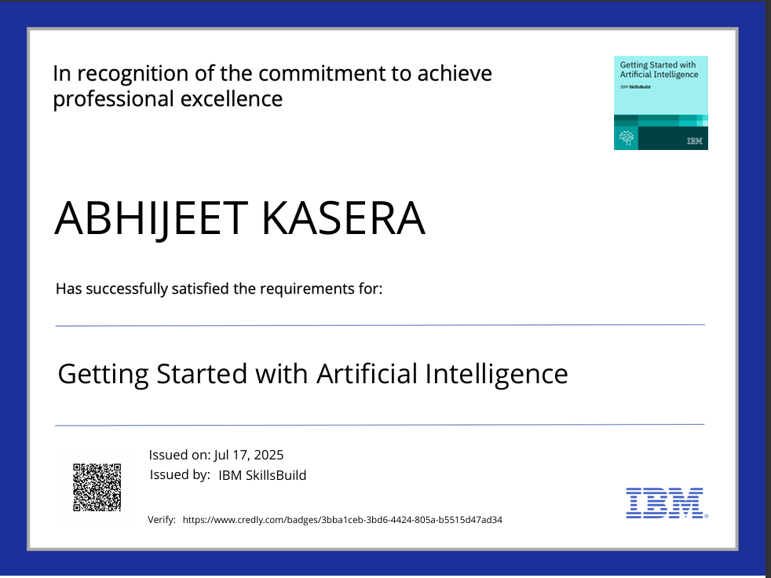
IBM Certifications
Screenshot/ credly certificate( getting started with AI)

Slide 18

IBM Certifications
Screenshot/ credly certificate( Journey to Cloud)

Slide 19
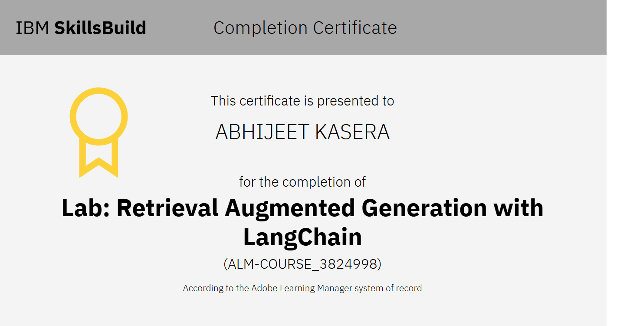
IBM Certifications
Screenshot/ credly certificate( RAG Lab)

Slide 20
THANK YOU

